Slide 1
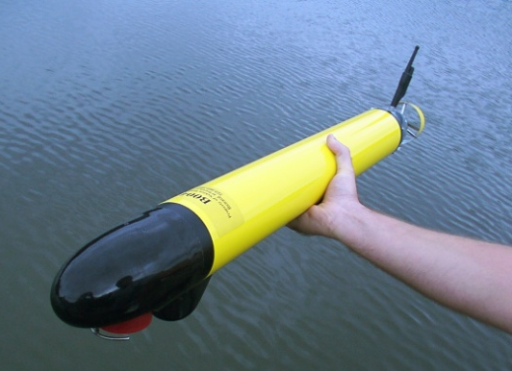
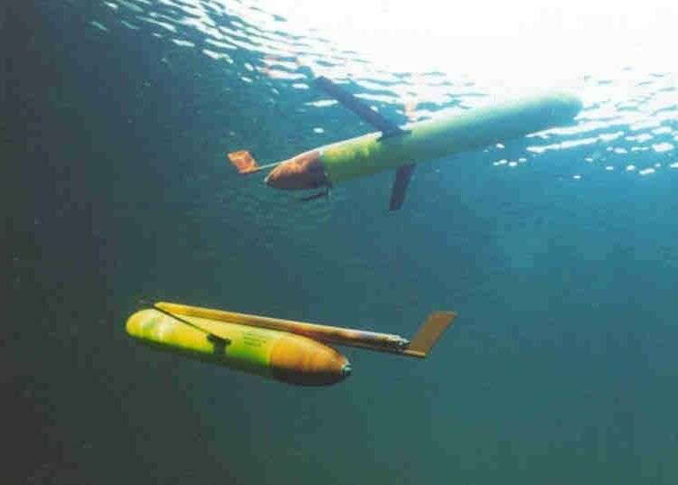
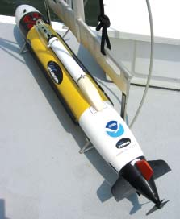
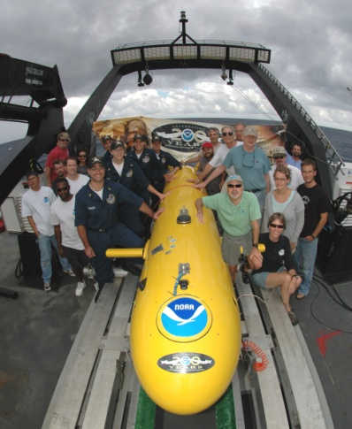
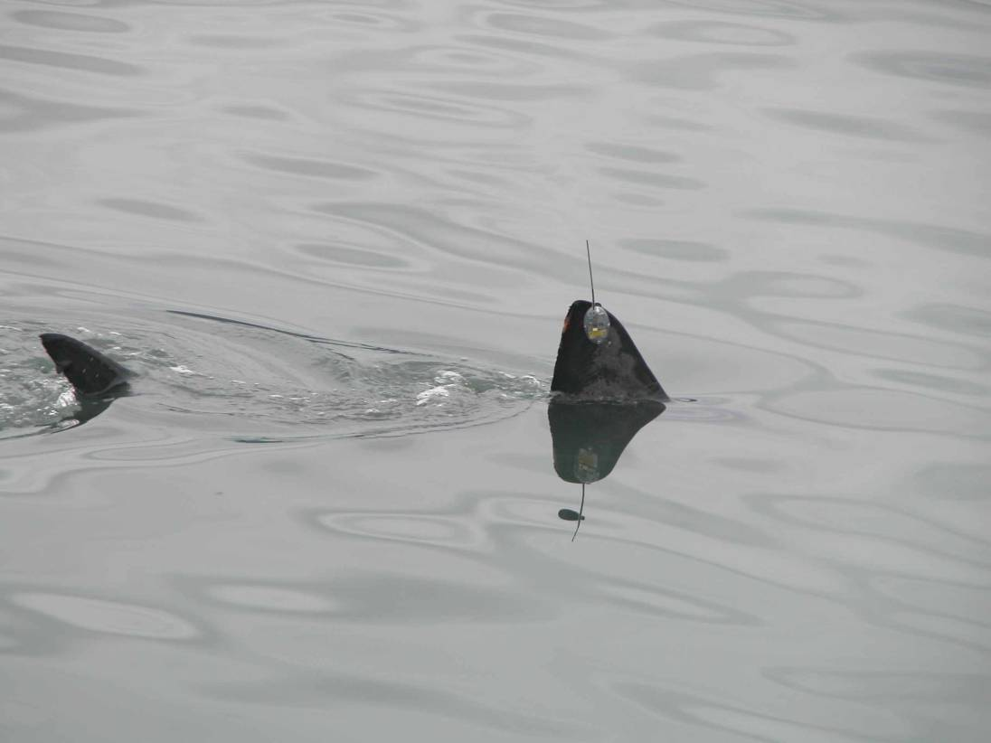
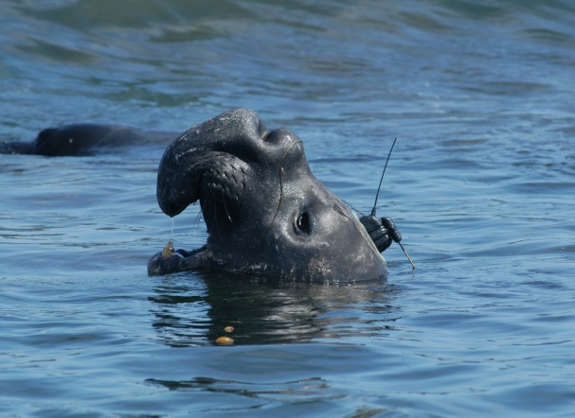
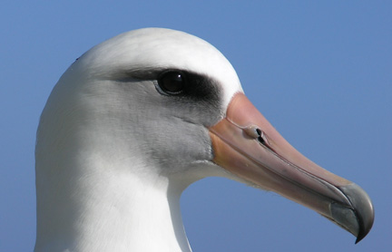
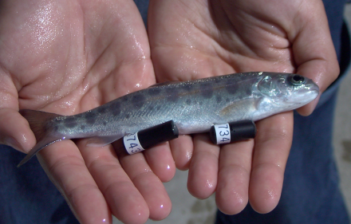
Accessing the Sea: Unmanned Platforms, Sensors and Infrastructure for Decision Support
2010 NOAA Technology Summit
Dr. Reginald Beach, Mr. Frank Cantelas

Slide 2
Some Benefits of Unmanned Systems
Unmanned Systems ability to increase the pace, scope and efficiency of accessing or monitoring the environment to support Decision Making
Complement ships and manned aircraft:
  Potential for Longer Duration Observations
  Can Reach Remote, Inaccessible or Dangerous Locations
Can Increase Data Quality over Traditional Methods
Affordable, Scalable, Common Standards
It’s a rolling boil on many fronts…….
  Platforms, Sensors and Infrastructure

Slide 3
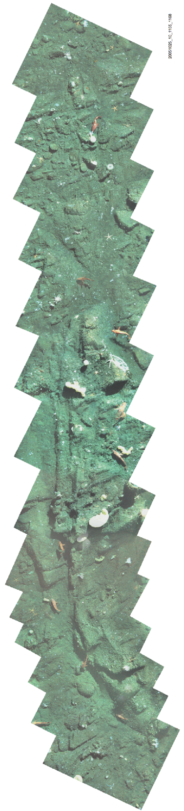
AUV Mapping of West Coast Groundfish
Team: NMFS NWFSC, OSU, & WHOI
Mosaic Courtesy WHOI (H. Singh)
Notes:
Nested data is very valuable to fisheries scientists.
The photo mosaics are the icing on the cake

Slide 4
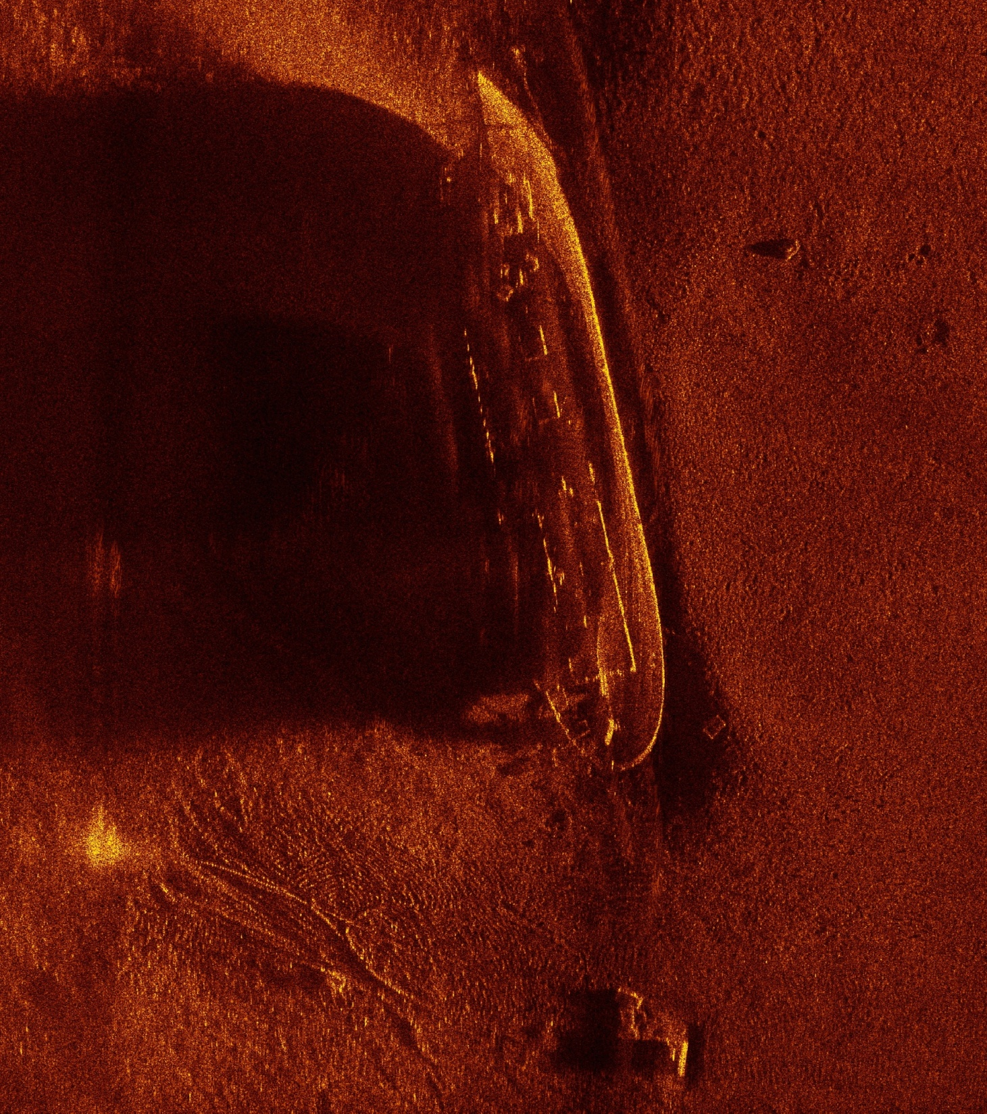
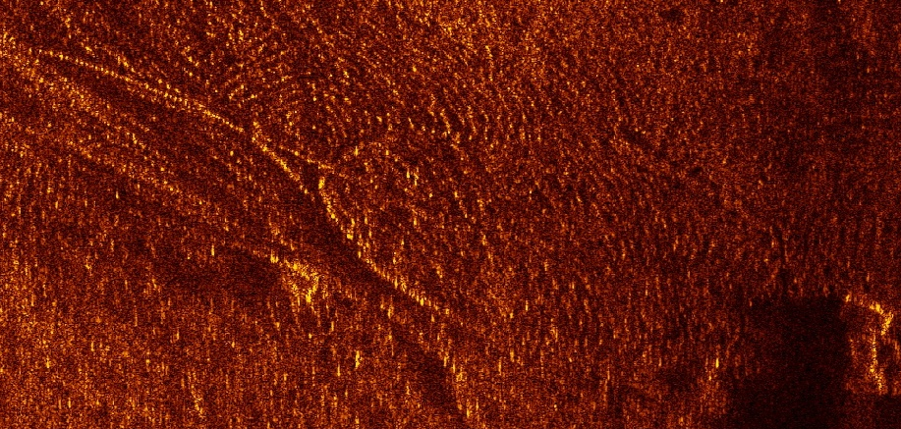
Synthetic Aperture
Sonar
SAS-12
(Bluefin AUV)
Prudence Island
Wreck Image
Anchor Chain

Slide 5
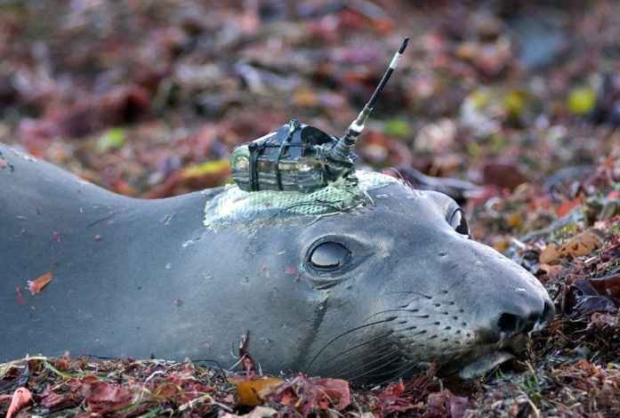
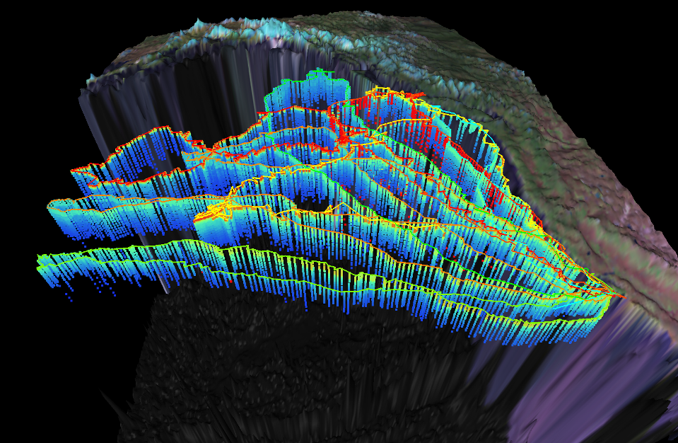
CTD tags Elephant seals……looks like a Glider!
22
Temperature
0

Slide 6
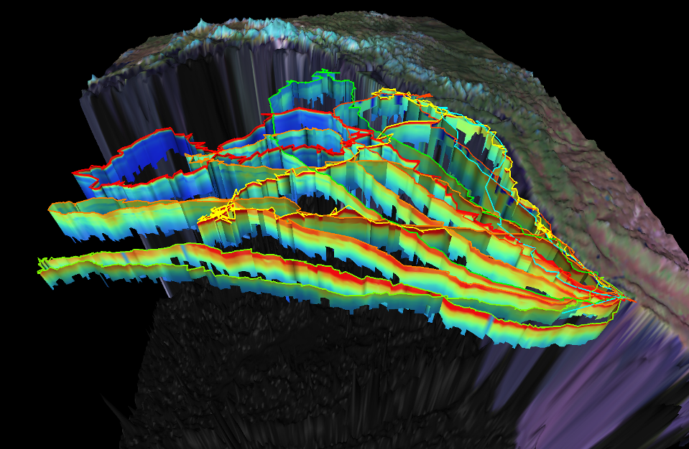
CTD tags Elephant seals……looks like a Glider!
40
Conductivity
30

Slide 7
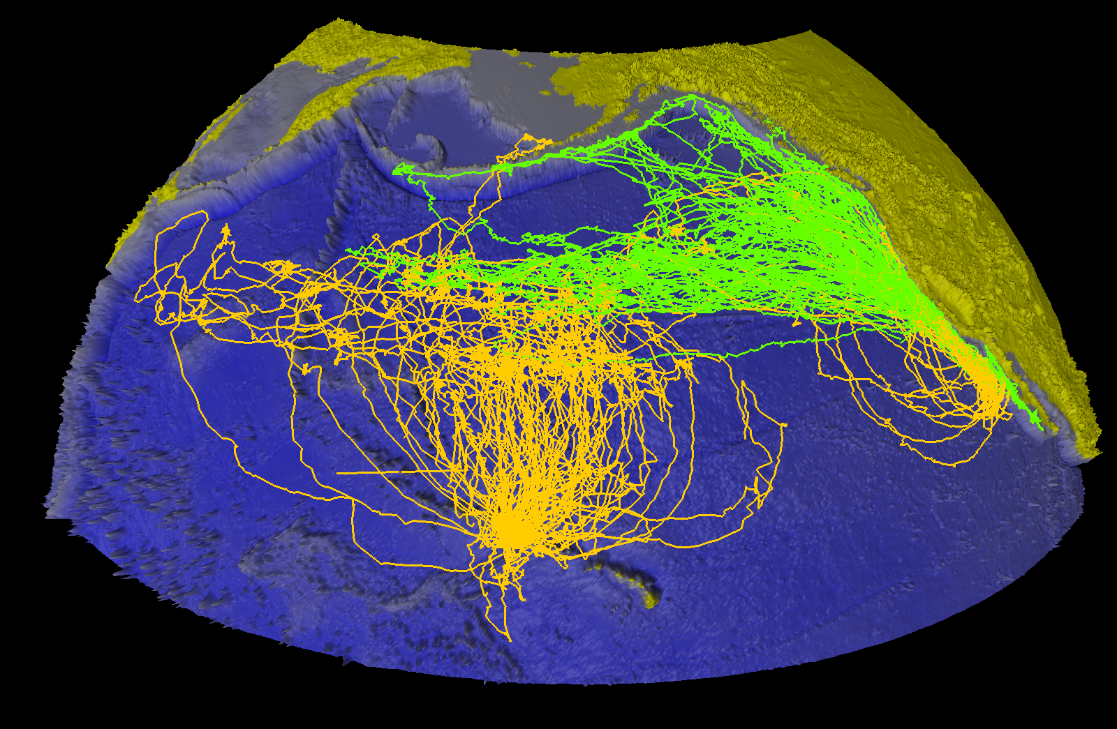
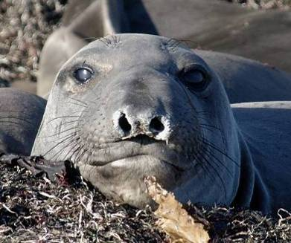

Slide 8
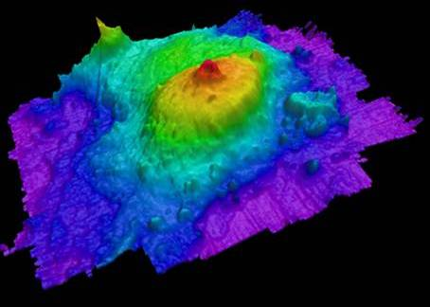
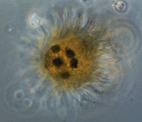
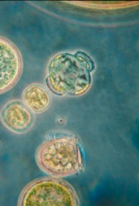
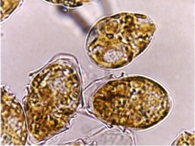
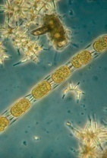
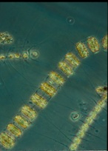
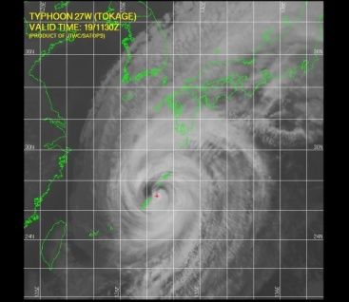
NOAA Unmanned Systems Missions
Hydrographic Survey/ Port Security
Benthic Ecosystem Assessment
  Habitat Mapping
  Fisheries Surveys
  Deep Exploration
  Maritime Archaeology
Water Column Ecosystem Assessment
  Fisheries Surveys
  Regional and point source events (e.g., DWH)
Oceanography
  Ocean Circulation and Structure
  Climate and Weather observations
  Hurricane Forecasting

Slide 9
NOAA AUV Roadmap
Identifies platforms and missions that unmanned systems (primarily gliders and propeller driven AUV’s) can fulfill.
Content:
  Vision
  Operating Principles
  AUVs in NOAA Missions
  Recommendations
Status
  Approved by Research Council Aug 2009
  Under review by PA&E
Outlook? PPBES => $0
=> TF on Unmanned Systems

Slide 10
“Grassroots” Capability Demonstrations
2005 Katrina Harbor Surveys (NOS)
2008 AUVfest demonstration of dual-use capability of Navy MCM platforms for marine archaeology+
2009 First TransAtlantic Glider (IOOS)
Bonaire Coral Mapping (2008), NOS Marine Debris (2010), NMFS Scallop Survey (2011), Thunder Bay Sanctuary Expansion Survey (2010)
Animal Borne Sensors (TOPP, POST, Narwals, Applications for Climate, Arctic, IOOS, Weather)

Slide 11
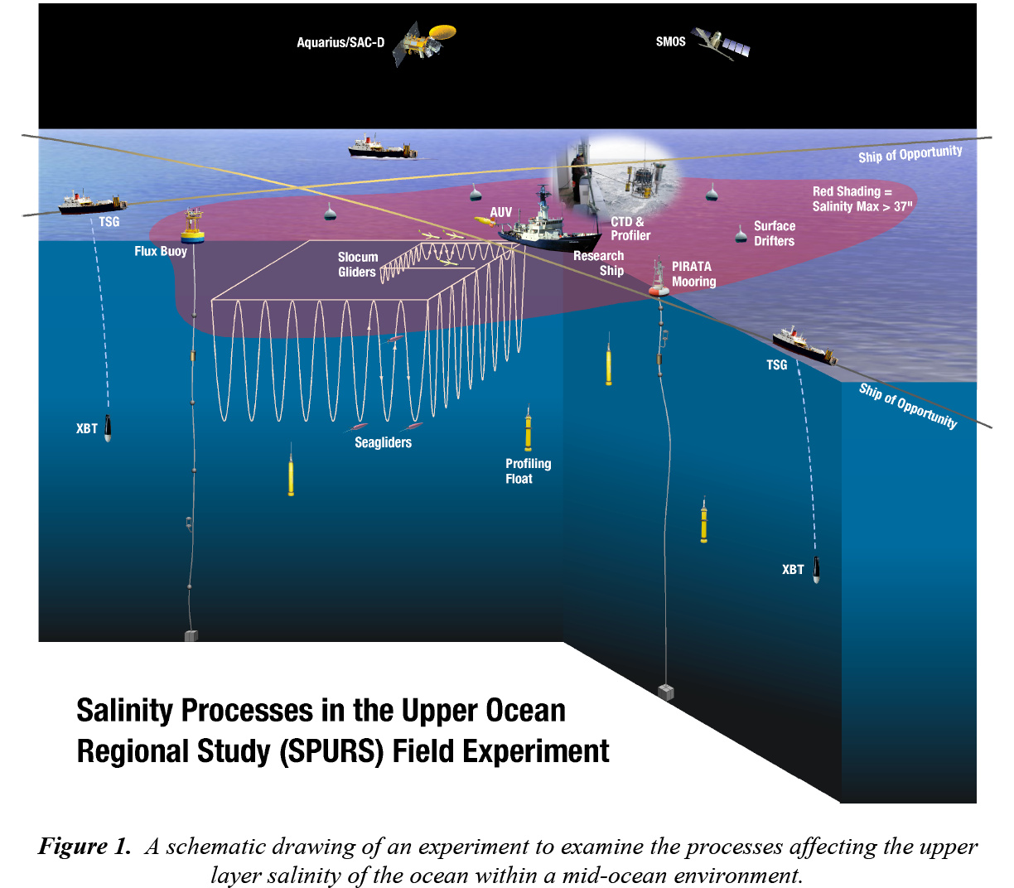

Slide 12
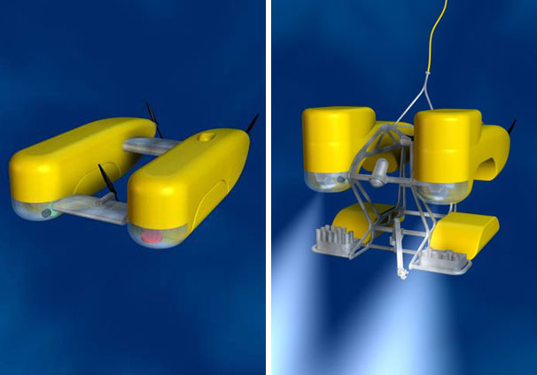
New Platforms
Solar AUV, Long Endurance, Hybrid Surface / Sub Surface
ONR Fuel Cell AUV, 90 days, 20 kts sprint
NEREUS: Full Ocean Depth, Hybrid ROV / AUV), uses Ceramics
Unmanned Surface Vessel – Wave-Driven Locomotion, Long Endurance
NDSF Sentry – Photo Mosaic AUV
UK AutoSub - UnderIce AUV
ENDURANCE (Environmentally Non-Disturbing Under-ice Robotic ANtarctiC Explorer)

Slide 13
Sensors –
Many Interagency Sponsors
R. Camilli - Mass Spectrometer used in DWH
O. Schofield – Glider Fluorescence Sensor for primary productivity measurements
EcoPuck (Optics for Ecosystem Observations)
Water Sampling – Physical Samples
Animal Borne Sensors: Acoustic Business Tags, Ocean Tracking Networks
Growing Number of Active and Passive Sonars for Mapping (MB, SSS, SAS, Forward-Look) and Detection

Slide 14
[Growing] Infrastructure
Asset Pools: NIUST, CIOERT, NSWC-PC
$55M, 5yr Navy Procurement of 150 Gliders, Glider Operation Center @ NAVOCEANO
$77M, 5yr Navy Procurement of AUV’s, for TAGS-60 Hydrographic Surveys
NSF Ocean Observing Initiative; 3 Fleets of AUVs and Gliders Operationally Supported
IOOS Regional Associations (Gliders)
JSOST-F&I Task Force on Unmanned Systems
  NOAA TFUS, Meets every 2 months

Slide 15
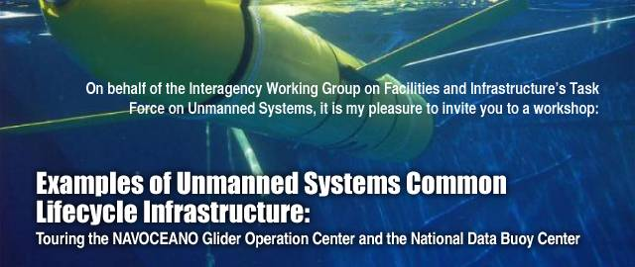
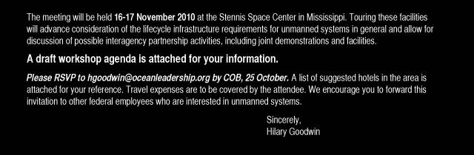
To Be Rescheduled
in 2011

Slide 16
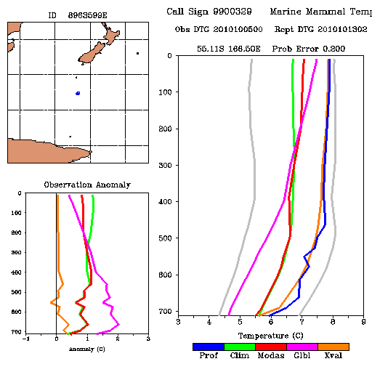
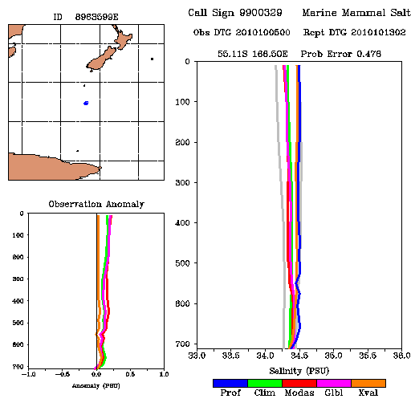
Marine Mammal
Temp and Salinity Profiles

